Slide 1


ONLINE GROCERY SHOPPING IN INDIA - SENTIMENT ANALYSIS
By:
Adrija Karmakar
Supervisor : Mr. Taranga Mukherjee

Slide 2

Flow Chart of this Project
Data Collection
Data Cleaning
Data Description
Removing Null value
Removing Emojies
Data PreProcessing
Machine Learning Approach
Removing punctuation
Removing unimportant columns, keep only Review and Rating
Model Application on dataset
Tokenization, StopWords removal, POS tagging, Lemmatization
Lexicon Based Approach
{
Dictionary Based Approach
Corpus Based Approach
TextBlob
Which App is better ?
SentiWordNet
Vader

Slide 3

Introduction

Slide 4

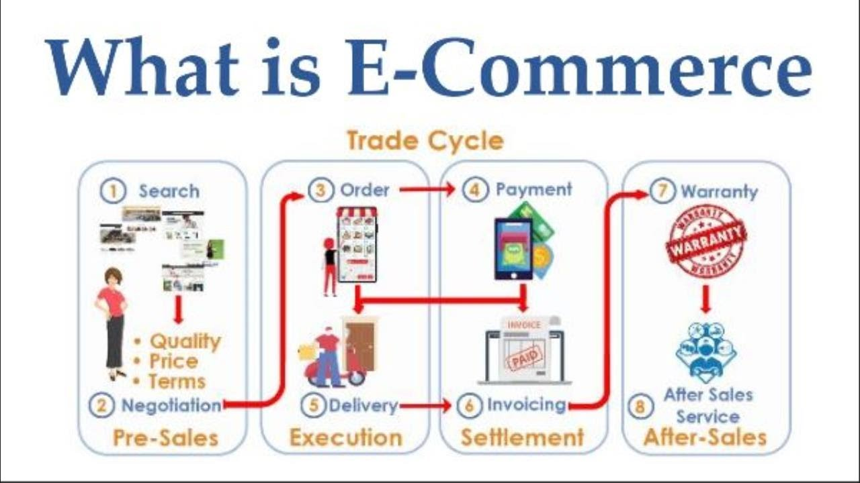
E-commerce (electronic commerce) is the buying and selling of goods and services, or the transmitting of funds or data, over an electronic network, primarily the internet. These business transactions occur either as:
Business-to-Business (B2B),
Business-to-Consumer (B2C),
Consumer-to-Consumer/ Consumer-to-Business.
Mobile e-commerce (m-commerce) refers to online sales transactions using mobile devices, such as smartphones and tablets. It includes mobile shopping, banking and payments. Mobile chatbots facilitate m-commerce, letting consumers complete transactions via voice or text conversations.

Slide 5
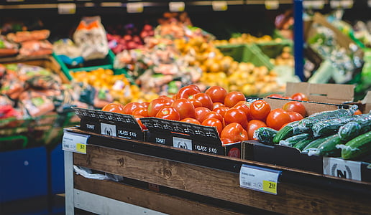
Grocery app development services in India have helped grocery delivery companies to revolutionize the way people shop for their groceries. We’ve seen significant growth in the number of grocery stores that offer online shopping, and this is only going to increase as more Indians adopt smartphones over the next few years.
The recent covid-19 pandemic has driven increased demand for these services. Whether healthcare, production, or management, every sector strives to improve online shopping experiences by providing better customer service. Among the leading grocery apps available in India are Big Basket, Blinkit, etc. It is becoming more and more popular because it saves people time and effort by providing them with a comfortable facility.
It’s no longer clothes or books or makeup items that people want to buy online. Even when it comes to buying everyday groceries, people are increasingly turning online, amid the pandemic. A recent study indicates that online grocery shopping is likely to grow more than two-fold as more shoppers are now ordering items online.
Multiple studies show that online grocery shopping has surged in the last few months. While studies indicate a 76% growth in the online grocery market as compared to last year, another study by Local Circles found that 80% of people ordered groceries online for convenience and not price. Due to the pandemic and lockdown, while sales on online grocery sites such as Grofers and BigBasket increased, aggregators like Zomato, Swiggy, and JioMart also started delivering groceries.
Amazon and Flipkart have also seen an increase in grocery orders. As reported in Economic Times, BigBasket says that since March, its new customer acquisition grew three-fold in terms of orders, compared to pre-COVID, while retention of new customer cohorts has increased by 60%.

Slide 6
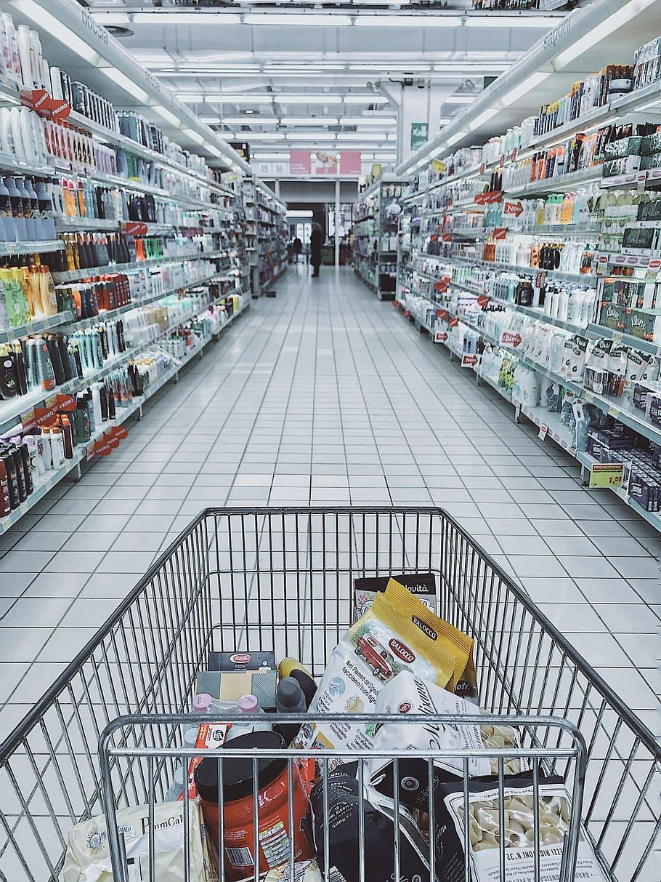


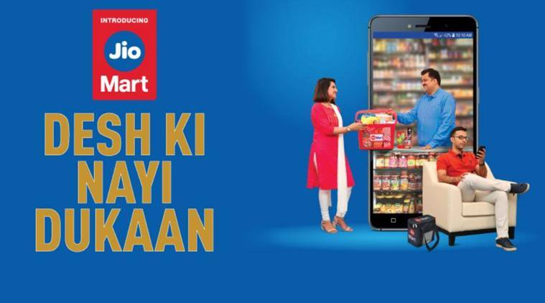
OBJECTIVE
As, for the first time in India, millions of people from different places and communities order groceries from the online delivery apps. So, just like it is new for Indian customers to use these apps, it’s also new for the app company to build, grow, manage orders, maintain good services, and satisfy customers.
Here, in this project we picked up the top three online grocery apps in India i.e., BigBasket, Blinkit, and Jio Mart, and analyze customers’ sentiments over these three apps using their reviews. We manage to find out which app is better than the other two and why, also it will help new app makers to look up at the glitch side of these apps that they can rectify in future.

Slide 7
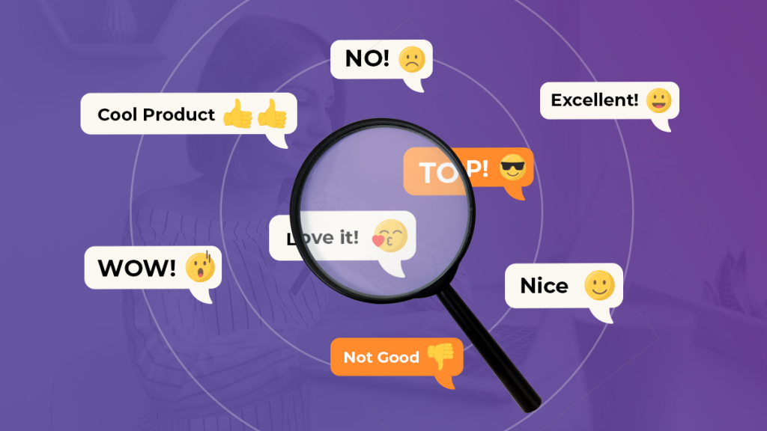

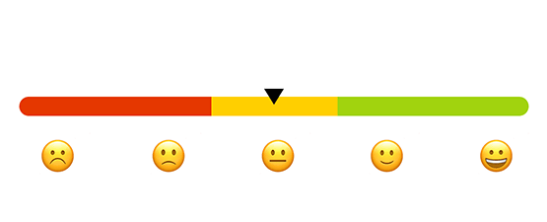
SENTIMENT ANALYSIS
Sentiment Analysis is a Natural Language Processing task; it refers to finding patterns in data and inferring the emotion of the given piece of information which could be classified into one of these categories: Negative, Neutral, and Positive.
It’s a form of text analytics that uses Natural Language Processing (NLP) and Machine Learning.
Sentiment analysis is also known as “Opinion mining” or “Emotion Artificial Intelligence”.

Slide 8

Here the method we have used in our project is Lexicon-based Sentiment Analysis.
Lexicon-based Sentiment Analysis- One of the approaches or techniques of semantic analysis is the lexicon-based approach. This technique calculates the sentiment orientations of the whole document or set of sentence(s) from semantic orientation of lexicons. Semantic orientation can be positive, negative, or neutral. The dictionary of lexicons can be created manually as well as automatically generated.
Lexicon-based techniques use adjectives and adverbs to discover the semantic orientation of the text. For calculating any text orientation, adjective and adverb combinations are extracted with their sentiment orientation value.
The dictionary-based approach- In this approach, a dictionary is created by taking a few words initially. Then an online dictionary or thesaurus can be used to expand that dictionary by incorporating synonyms and antonyms of those words. The dictionary is expanded till no new words can be added to that dictionary. The dictionary can be refined by manual inspection.
Then we have tried to analyze by using the user rating and three types of dictionary-based approaches; i.e., TextBlob, SentiWordNet and Vader.
Sentiment Analysis
Lexicon-Based Approach
Dictionary- Based Approach
SentiWordNet
Vader
TextBlob

Slide 9

METHODOLOGY
Data Collection
Data Cleaning
Data Analysis
TextBlob
VADER
Result
SentiWordNet

Slide 10


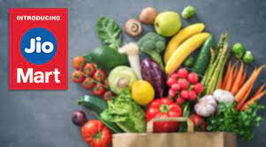
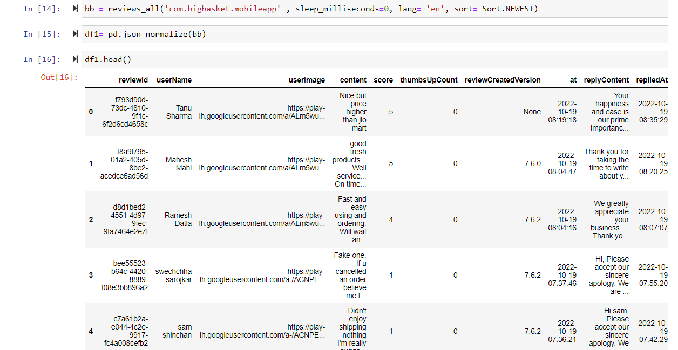

D
Data Collection
The data of customer review of three top online grocery home delivery app bigbasket,Blinkit , and jio mart have been collected from the Indian google play website . we scrapped the data from google play in python .this data contain 235687, 267824, and 204424 reviews till 19th October 2022.

Slide 11

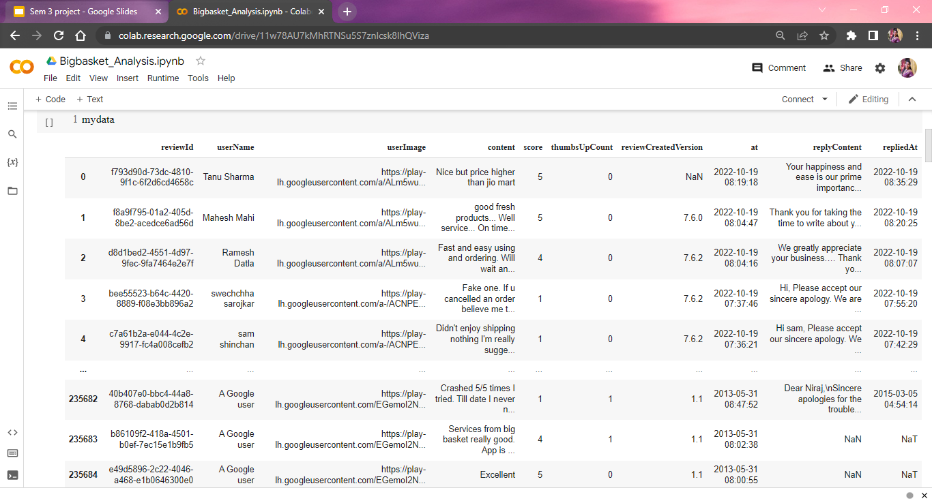
DAData Description
How many people liked the review
The company’s reply on that particular review of that users
User’s review
Customer Name
The ratings on a scale 0 to 5.
When the user made the comment
When the company replied.

Slide 12

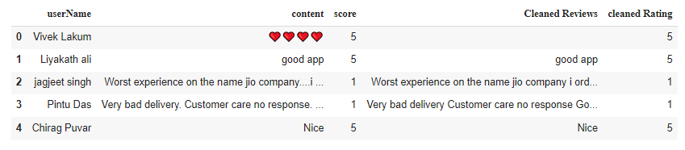
Data cleaning
In the first step, we try to eliminate missing values from the data. After removing the missing values, we drop the columns that we do not use and remove special characters, emojis and numerical values from each review using Regular Expressions. We then got the cleaned data
Raw data
Cleaned data

Slide 13
Steps of TextBlob Analysis
Tokenization + Lower Case
Stop words Remove
Lemmatization
Parts Of Speech (POS) tagging
Subjectivity
Lexicon Based Approach
Polarity

Slide 14

Example
‘I am watching a movie.’
After removing
StopWords
POS
tagging
Tokenization + Lower Case
Lemmatization
i
am
watching
a
movie
watch
movie
watching
movie
watching(v)
movie(n)

Slide 15


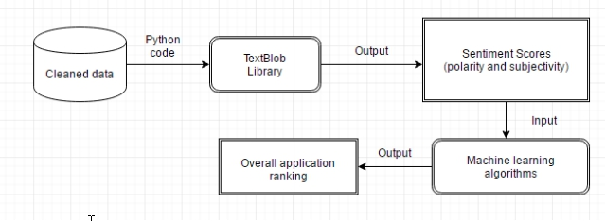
TextBlob
It is used for sentiment analysis for textual data. Textblob uses NLP and NLTK for analysing the data.
NLP - Natural Language Processing is a method to makes data usable for the system.
NLTK - Natural Language Toolkit is a english based python package.

Slide 16
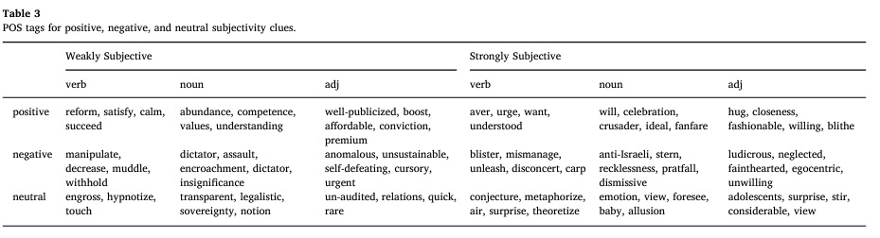
Polarity
Subjectivity
TextBlob output for a polarity task is a float within the range (-1.0,1.0) where -1.0 is a negative polarity and 1.0 is positive. This score can also be equal to 0, which stands for a neutral evaluation.
It measures if the text is fact or opinion based. Whereas, a subjectivity/objectivity identification task reports a float within the range (0.0,1.0) where 0 is a very objective sentence and 1 is very subjective.

Slide 17

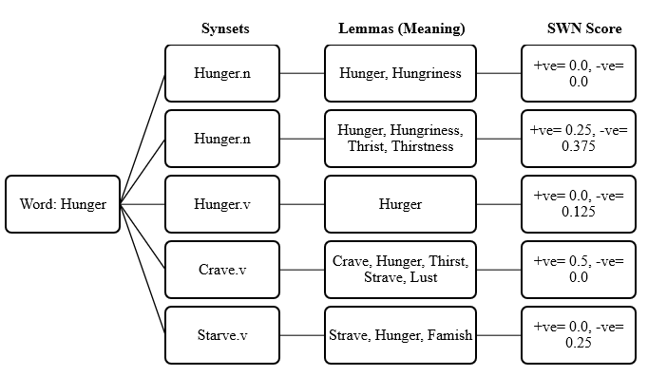
SentiWordNet
Example:
{
Let’s take a word ‘Hunger’
SentiWordNet uses the WordNet database. NLTK module includes the English WordNet with 155 287 words and 117 659 synonym sets that are logically related to each other.
It is important to obtain the POS, lemma of each word. We will then use the lemma, POS to obtain the synonym sets(synsets).
We then obtain the positive, negative, objective scores for all the possible synsets (synonym set” — a collection of synonymous words).
if positive score > negative score, the sentiment is positive
if positive score < negative score, the sentiment is negative
if positive score = negative score, the sentiment is neutral
Senti
WordNet
Get a list of all the synsets against hunger
Get the polarity for all those synsets

Slide 18
VADER
x
Vader stands for Valence Aware Dictionary and sEntiment Reasoner.
It gives result of four dictionary keys: Positive, Negative, Neutral and Compound.
The sum of positive, negative, neutral is 1 or near to 1. We use Compound Score to find the sentiment.
Vader sentiment not only tells if the statement is positive or negative along with the intensity of emotion.
Here is how to read the measurements:
-1: extremely negative
1: extremely positive
0: Neutral or N/A
Compound Score =
√(x^2 +𝛼)
where x = sum of valence scores of constituent words,
and α = Normalization constant (default value is 15).
X calculated by the value of Polarity, Subjectivity and Intensity.
-1 < Compound Score < +1

Slide 19
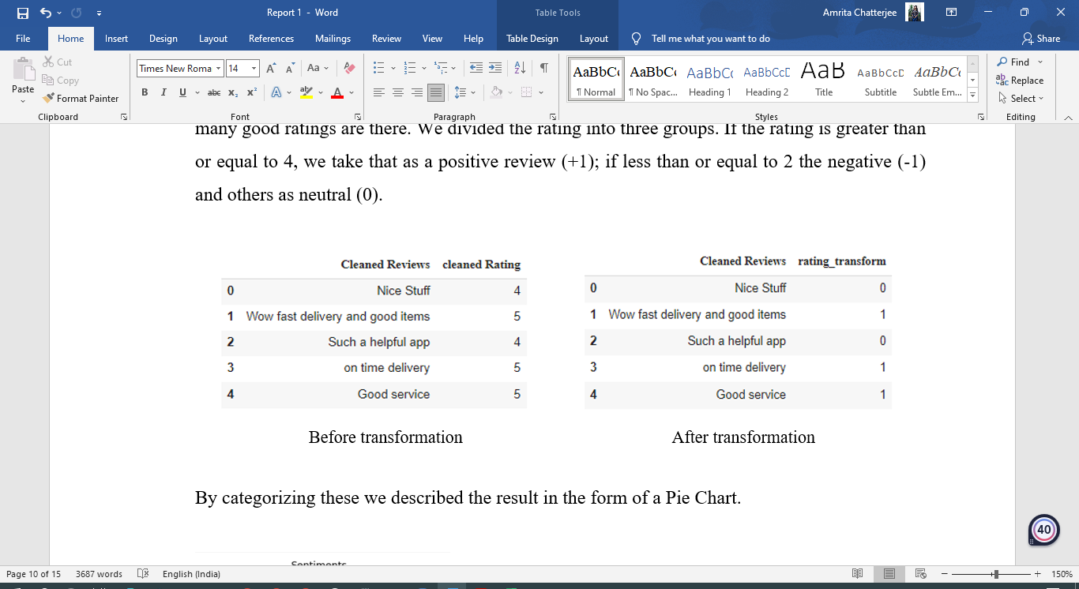
User Rating Based
We divided the rating into three groups:
If the rating is greater than or equal to 4, we take that as a positive review (+1)
If less than or equal to 2 the negative (-1)
Others as neutral (0).

Slide 20
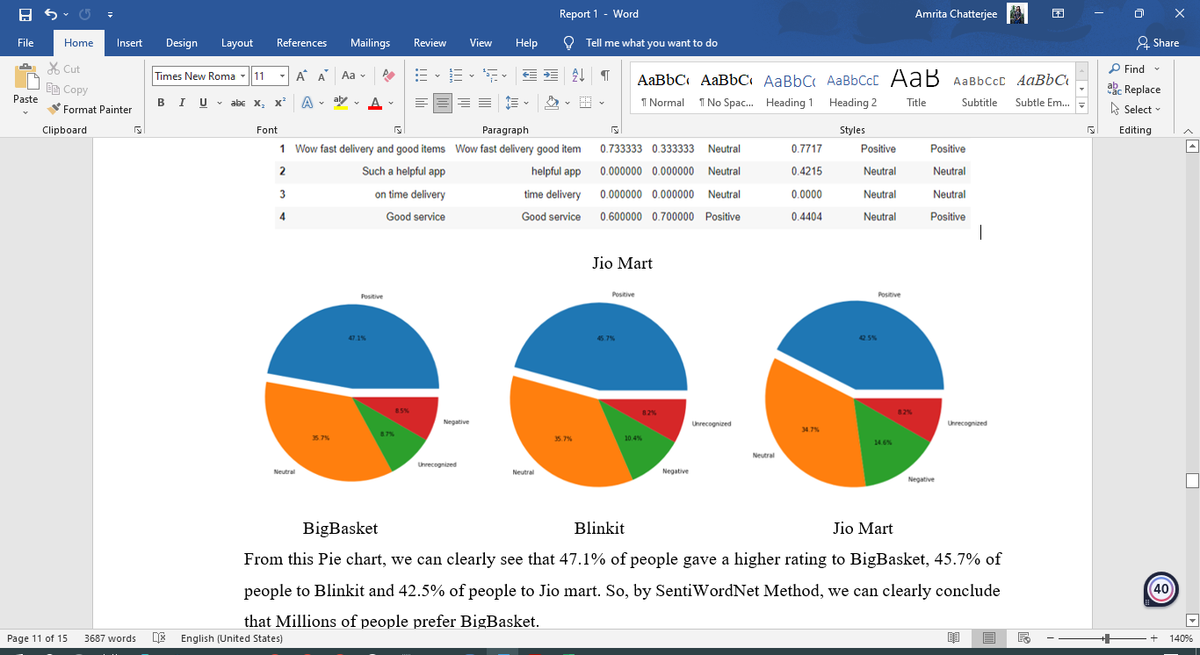
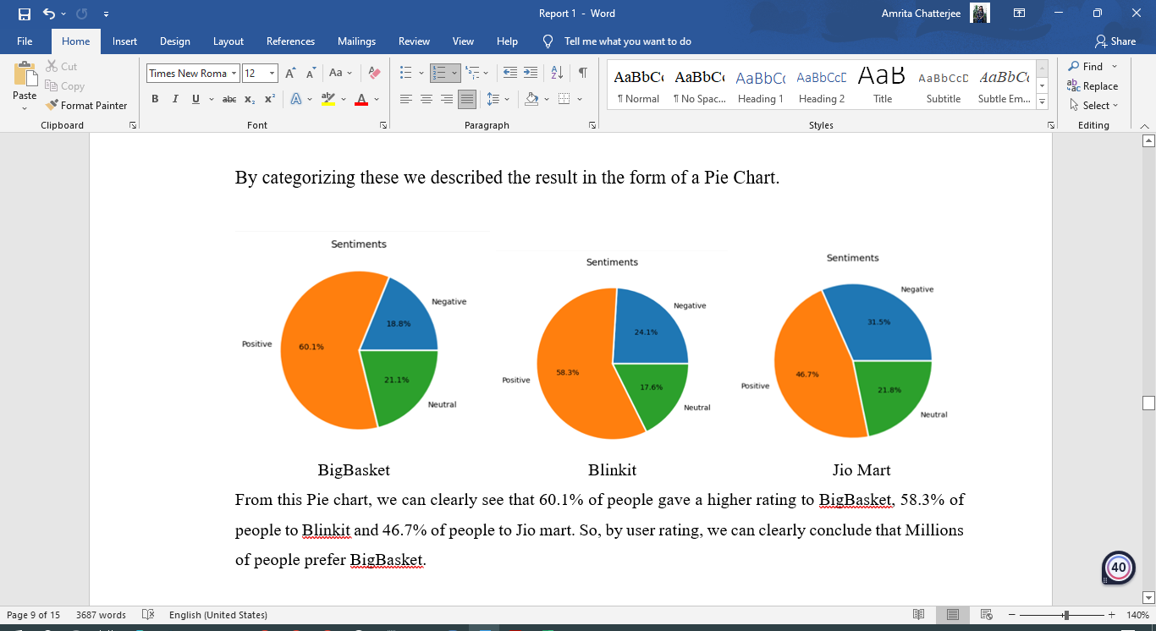
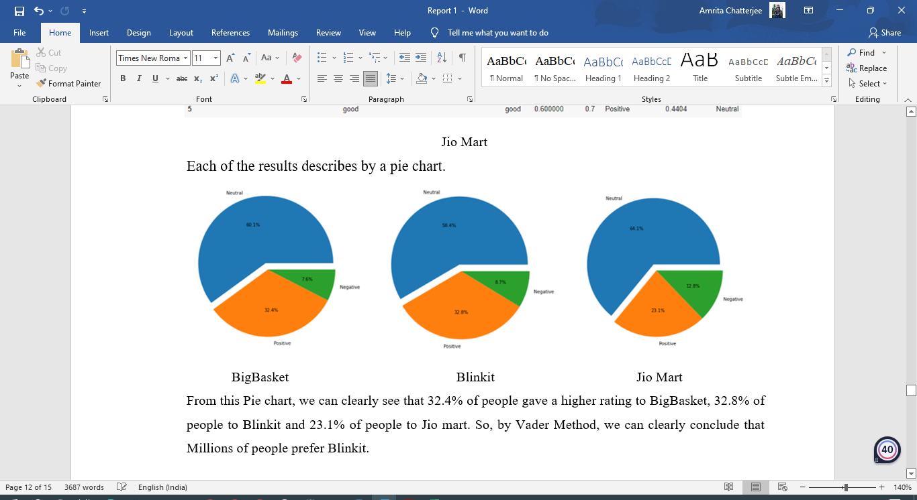
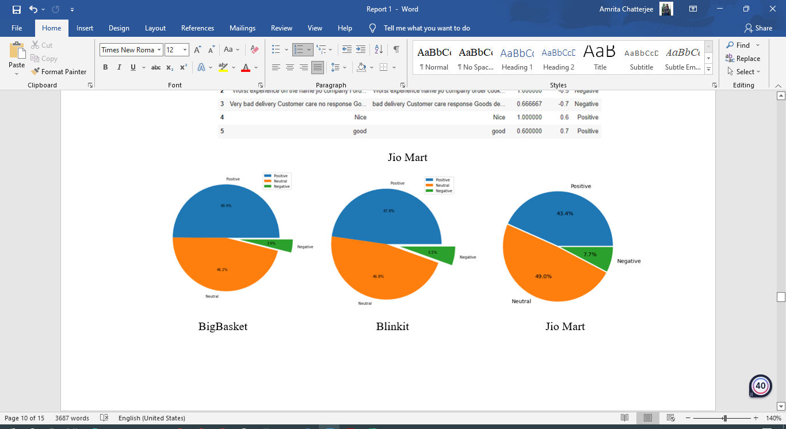
ANALYSIS
SentiWordNet :
User Rating Based Result :
Vader :
TextBlob :

Slide 21
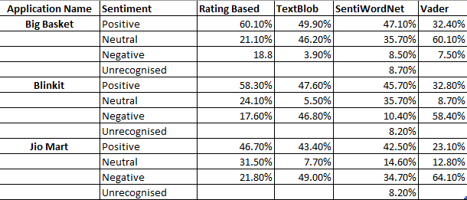
RESULTS
Which Model is Better?
Model Accuracy
{
TextBlob
SentiWordNet
VADER
Rating Based Result
Accuracy Result:
TextBlob : 70.2 %
SentiWordNet : 79.4 %
Vader : 77.4 %
Actual Class
SentiWordNet
Is better method for analysis
Predicted Class
BigBasket
is better Application

Slide 22
Conclusion
Advantages of Vader Method:
Works perfectly on social media type text.
It does not require any training data but constructed from generalizable, valence-based, human-curated gold standard lexicon.
Advantages of Sentiwordnet:
SentiWordNet operates on the database provided by WordNet. The additional functionality that it provides is the measure of positivity, negativity or neutrality as is required for Sentiment Analysis.

Slide 23


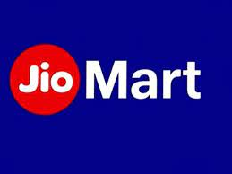
Grocery Application Comparison
82.8%
81.4%
57.1%
SentiWordnet Method
131 Minutes
485 Minutes
Reply those users who give only 1 OR 2 rate to the Jio Mart App.
Average Reply time

Slide 24
SNAP-SHOT OF NEGATIVE REVIEWS
Worst app , Very poor service and unprofessional. I ordered grocery, first of all they postponed delivery date and later on cancelled my order without my consent. I will never use jio mart in future.
Very bad experience 20 days no any product delivery no record jio coustomer side where dilever items only say round and round talk please uninstall application my money deducted 3 week ago no send my order really poor service 01 0ct 2022 untill not delivered 19 10 2022 not delivered frud company I'll go consumer court now.
Don't buy any item all fake
Third class fraud jio mart First they send missing item then return tab disabled in app and then customer care officer talk rudely and not listen my issue #fraudjiomart
Slowest app award goes to jio marT
who takes 10 days to deliver ,are you from this digital world or located at some remote village...10 days really ?
Worst app, every time i order something it's goes cancelled
They don't give you delivery on time and you west your time nd money also so pls don't download this app don't west your time and money here they just make you foo.
Comparatively very costly i feel
Wrong item delivered.
Getting OCD or Near to expiry products , Some time Quality is also not good, The Delivery people not able understand simple Directions, They were not able to listen it's also a problem not all, some People.
After taking delivery charges they ask to change location as per their convenience
All appels are rotten .It's totally westage of money.
Very poor again one damaged product delivered inside packing no resolution.
I have issues with the order and there is absolutely no one to listen to in the chat section instead want us to write email for every order with the issue. Each order has some issue these days
.
Horrible delivery service
Wrong item deliverd
What 3rd class Grocery delivery App Ye 3 din tk grocery Deliver nai kr paye na delivery walo se koi contact nai ho pa ra customer service wale bhi clear nai kr paye ki kab delivery hogi .😡😡😡😡😡😡😡😡😡
No Delivery! Area is out of bounds, but only for some customers like me as I can see bigbasket truck right outside delivering order next door. Support team is so inadequate and inefficient that the only two answers they are scripted to mention is one, kindly place your order again as its mapping issue. If somebody is not stupid enough to place order again and again. Then second script, we are very sorry, but your address is out of delivery bounds.
Very very pathetic shopping app. No time value no problem solution. Delayed without any reason & none of response. Pathetic.. bakwas ...nonsense app.
All groceries and vegetables rates /prices are too high
App is horribly slow.
App get stuck always nothing works fine tat mad dilivery person have stolen my neighbours order everything recorded and now the app sucks day by day BB IS BECOMING WORST
For my friends it is free delevery and more me is rs.50 .. Loot macha rakhi hai !!!

Slide 25

Future online grocery app makers should go through the followings points:
The Delivery Area of Grocery App should be Wide (Both City and Rural).
Delivery time should be minimised.
Cost of the products should be same or less than the market value.
App should be easy to use.
Customer Service (Care) should be well.
Limitation:
We have a lot of language mix in the Dataset.Expect the English Language we can not determine the other texts.
While writing the reviews users use the chat language ( like: vry, gooooood, asap etc.)
Wrong Spelling also impact in our decision making.
We cannot determine the emojis, sarcasm type statements.

Slide 26

BIBLIOGRAPHY
https://wordnet.princeton.edu/documentation
Z. Nanli, Z. Ping, L. Weiguo, and C. Meng, “Sentiment analysis: A literature review”, Proceedings of the International Symposium on Management of Technology (ISMOT), Hangzhou, IEEE, pp. 572-576, 2012.
Ratnaparkhi Adwait. A maximum entropy model for part-of speech tagging. In: Proceedings of the conference on empirical methods in natural language processing, April 1996
Asian Journal of Computer Science and Technology ISSN: 2249-0701 Vol.8 No.S2, 2019, pp. 1-6, © The Research Publication, www.trp.org.in
Sentiment Analysis and Opinion Mining April 22, 2012 Bing Li
https://textblob.readthedocs.io/en/latest/quickstart.html#quickstart

Slide 27

!! THANK YOU !!
We would like to say thank you to our honorable VC, Prof. Saikat Mitra
and respected DIRECTOR of the Applied Science Dept, Prof. Sukhendu Samajdar &
HEAD OF THE DEPT., Prof. Anwesha Sengupta for giving us this great opportunity.
We would especially like to thank our SUPERVISOR Prof. Taranga
Mukherjee for his continuous support and guidance and we are also
grateful to the others faculty members.
Thank you to everyone...

